Slide 1
Recommendations from Yelp Dataset
Surya Mani Deepak Kancharla (CSCI - 5502)
Koushik Chennugari (CSCI - 5502)
Rajath Tellapuram (CSCI - 5502)
Laxmi Naga Santosh Attaluri (CSCI - 5502)

Slide 2
Problem Statement
Finding Local Connoisseurs - We aim at finding expert reviewers in the vicinity of a given area, this would help bring credibility about whom to follow to the users.
Rating attributes of a restaurant- We aim at rating the attributes of a restaurant which would help users to form an opinion about the restaurant. Attributes we considered are can be food quality, service, ambience & value for money.

Slide 3
Finding Local Connoisseur
Data Cleaning:
Yelp dataset covers a lot of categories such as restaurants, automotives, bar, shopping etc. We have cleaned it to focus only on the restaurants related category.
The DB that we have used is - MongoDB
As part of preprocessing, we had to deal with sparse data by filling the missing values by average values.
Removing the noise - Eg: rating for a review was :‘05-04-2016’
Data Integration:
We also had to join different files to get the data in the desired format.
We have different datasets about business data,user data and reviews data. We had to combine these files and do preprocessing.

Slide 4
Finding Local Connoisseur Contd..
Data Transformation:
The dataset was huge and required lot of preprocessing, so we have preprocessed the data using spark by launching an EMR cluster in AWS.
We had to lot of data transformations. Eg: We had an attribute called “yelping _since”. We had to convert that to age to use it as a feature for training the model.

Slide 5
Topical Authority
We are trying to find whether the user is knowledgeable for the “restaurants” category
We have considered following features which would be helpful for determining whether a user is knowledgeable or not
Total number of reviews given by the user in “Restaurants” category
Average rating given by the user in “Restaurants” category
Standard deviation in ratings
Number of useful votes user got in “Restaurants” category
Number of years since user created the account
Number of unique restaurants reviewed by the user
Number of friends for the user
Based on the above features, we have trained our model using Random Forest classifier.
We were able to obtain an accuracy of 0.92.

Slide 6
Topical Authority Contd..
The data has very less positive data when compared to negative data. Hence accuracy might not be a good measure of correctness.
Hence we have considered using F-measure,
F-measure=2*(precision+recall)/(precision+recall)
We got the following results
precision=0.46
recall=0.08
F-measure = 0.14
The recall is very less. So we have used a subset of the dataset which represents the original dataset. With this subset, we were able to reduce the skewness considerably.
We have created models using RandomForest and SVM based on the subset which we have chosen.

Slide 7
We got approximately similar F-Measure and accuracy for both the models. The best results that we were able to get are
precision=0.69
recall=0.47
F-measure = 0.564
Accuracy = 0.769

Slide 8
Location Authority
Yelp dataset does not have user location in it. This has become one of the biggest challenge for making the accurate predictions.
We are using the business location i.e., restaurant location which were reviewed by the user and plan on using Gaussian Mixture Model(GMM) to form the cluster based on those coordinated. We have considered the centroid of the most dense cluster as the location of the user.
We have chosen 15 miles as the threshold distance value. If the distance between the query location and elite user location is less than the threshold value, then that threshold value is returned as local connoisseur.

Slide 9
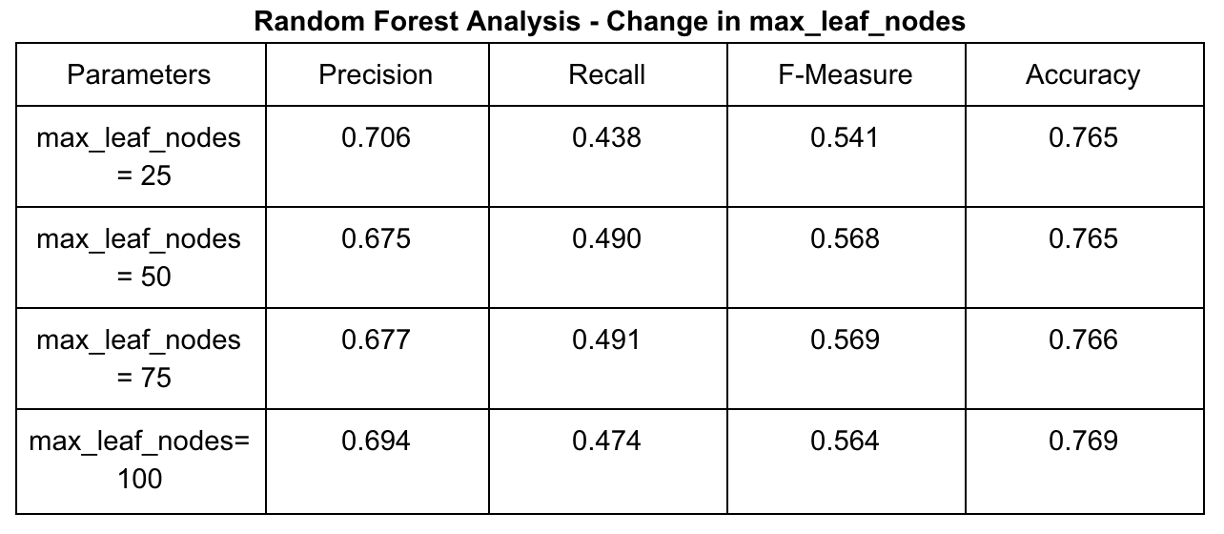
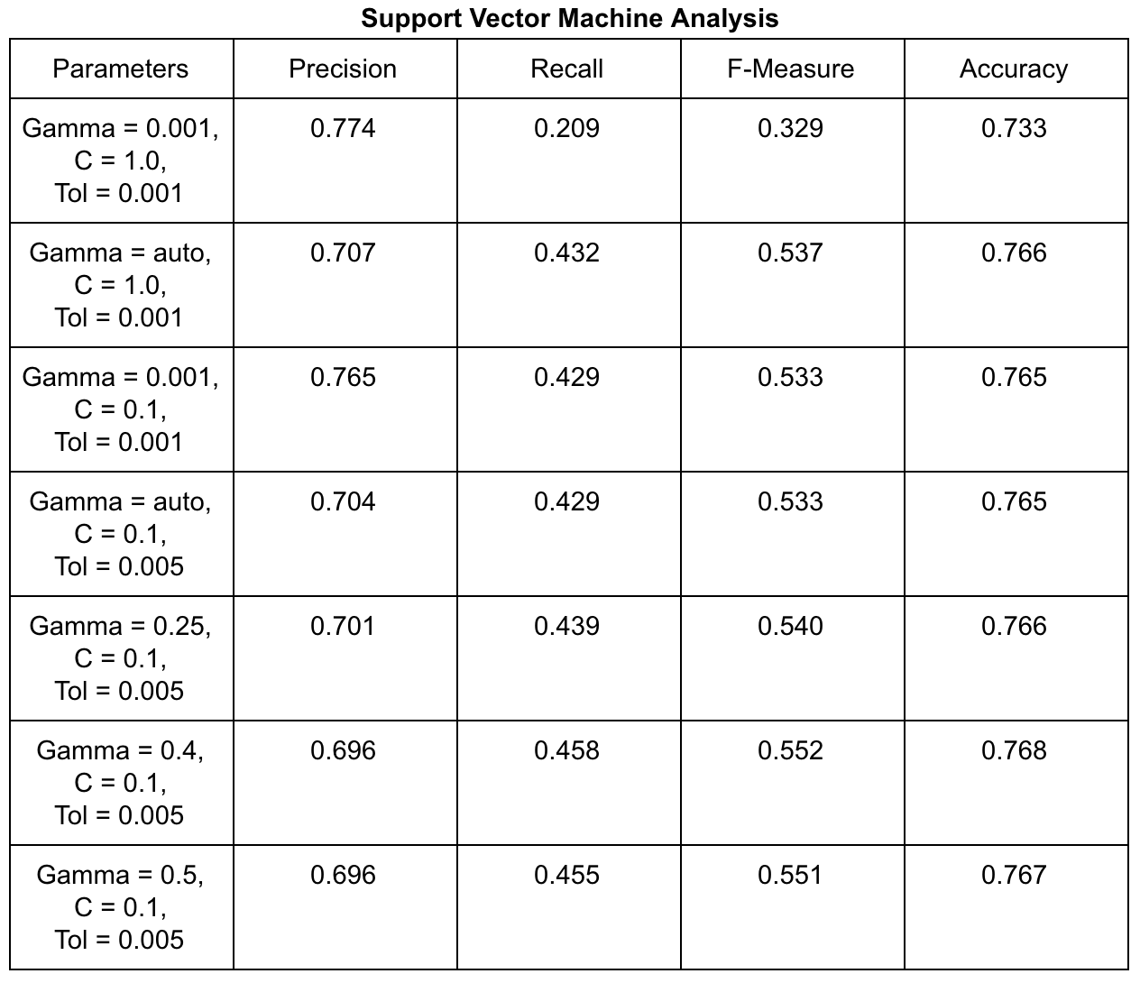
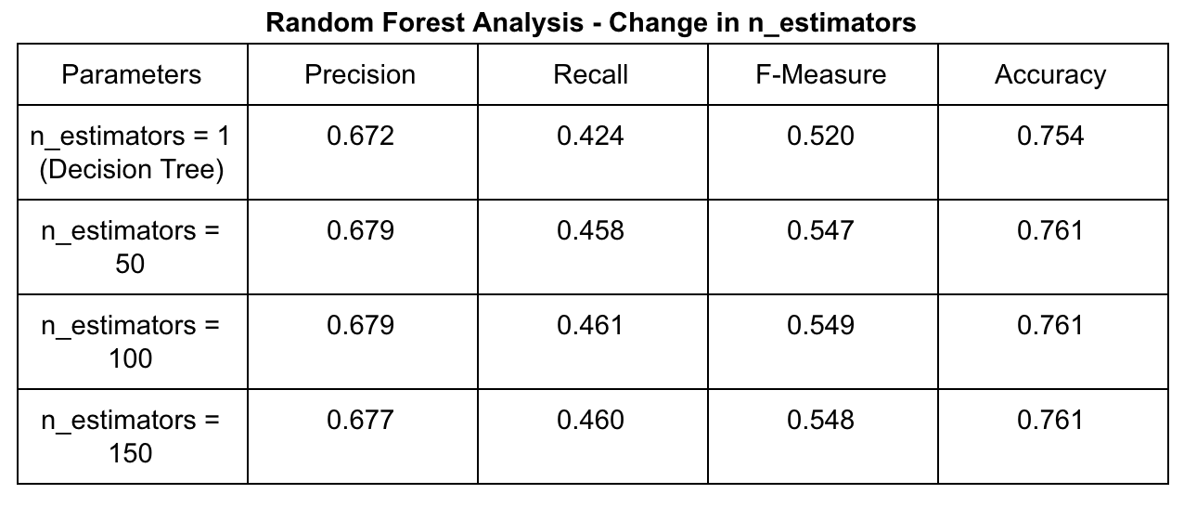
Results

Slide 10
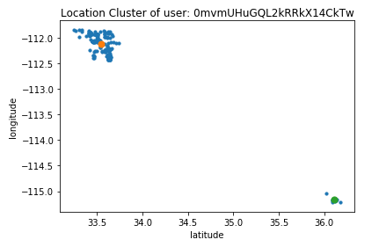
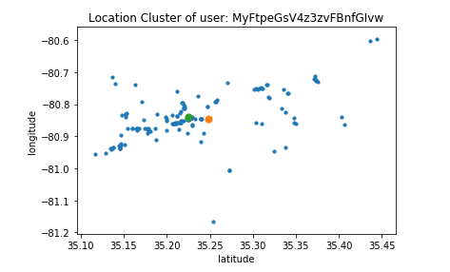
Location Clusters

Slide 11
Extracting attributes of a restaurant
We are evaluating attributes of a restaurant for which we filtered reviews that belong to a restaurant
Attributes we want to evaluate
Food Quality
Service Quality
Value for Money
Ambience

Slide 12
Topic Modelling
Performed LDA on the review text to form topics.
LDA was done using two approaches
Bag of words
TF-IDF
Split the review text into sentences and the sentences into words.
Lowercased the words and removed punctuations.
Stopwords and words that have fewer than 3 characters are removed.
Words are lemmatized , i.e. words in third person are changed to first person and verbs in past and future tenses are changed into present.
Words are stemmed , i.e. words are reduced to their root form.
Assigned the topics to the required attributes.

Slide 13
Rating the attributes
Used Stanford CoreNLP library to get the sentiment level (0-4).
Split the review text into sentences.
For each sentence, find the attribute using the LDA model and perform the sentiment analysis.
Maintain a map data structure to store cumulative scores for each attribute for every restaurant.
Average the scores for each attribute for a given restaurant.

Slide 14
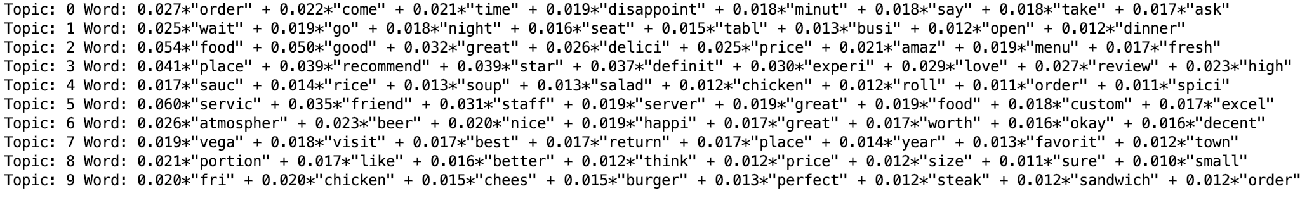
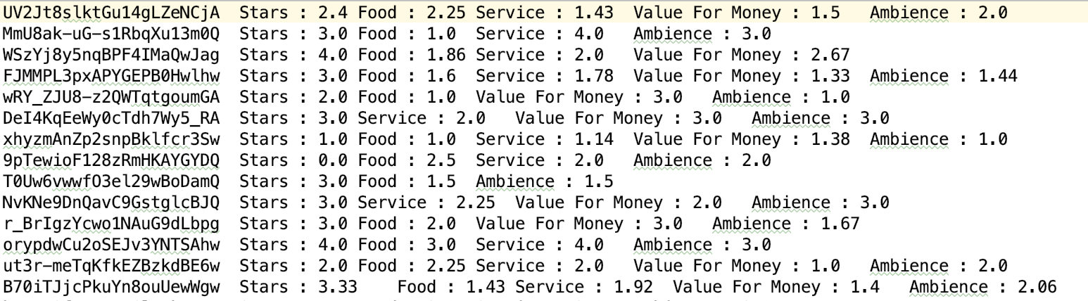
Results

Slide 15
Thank you

